Slide 1
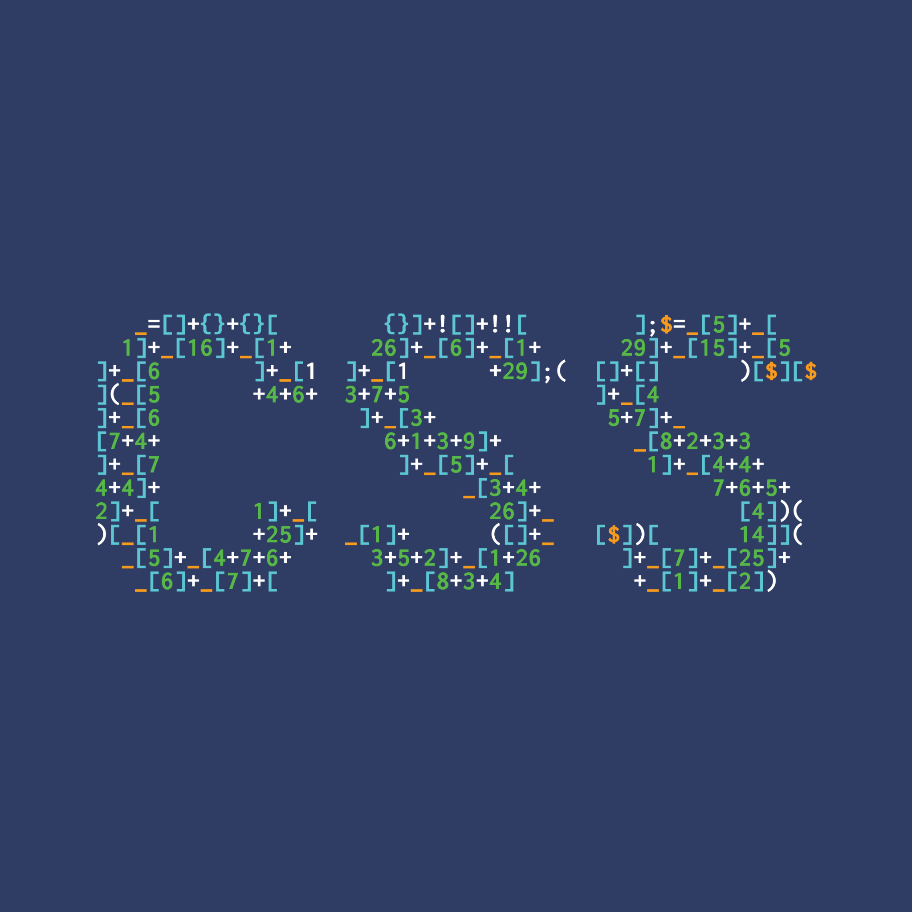
Introduction to Python
To “Hello World!” And Beyond
Jack Shilton
He/Him
ジャック#0394

Slide 2
What Is GDSC
What is a Developer Student Club?
GDSC is the workshop design division of CSS. Over the next year we will be handling all of the workshop content!
We are made up of a small Core Team, with each of us having our own speciality! https://gdsc.community.dev/university-of-birmingham/

Slide 3
To “Hello World!”...
Humble Beginnings
Python is a fairly simple, but powerful, programming language that is easy to use and can get you started in your programming journey!
GitHub Repository: _____
Notes:
Data Science
Artificial Intelligence
Natural Language Processing (NLP)

Slide 4

// Hello World in Java.
package uk.ac.bham.jxs.java_hello_world;
public class Main {
public static void main(String[] args) {
System.out.println(“Hello World!”);
}
}

Slide 5
// Hello World in Java.
package uk.ac.bham.jxs.java_hello_world;
public class Main {
public static void main(String[] args) {
System.out.println(“Hello World!”);
}
}
# Hello World in Python.
print(“Hello World!”)

Slide 6
Time To Run!
Compiling / Running Python
Writing this code is good and all, but how do we actually see the results of our efforts? Typically we will run this command in the terminal:
python3 [fileName.py]

Slide 7
Give it a Go!
helloWorld.py
print(“Hello World!”)
Terminal: python3 helloWorld.py

Slide 8
Speaking to Humans 101
Taking user input
Typically getting input from users in other languages requires a large amount of prep and handling, however Python ensures that it is easy and simple to both get data and process it!

Slide 9
// User input in Java.
package uk.ac.bham.jxs.java_user_input; import java.util.Scanner;
public class Main {
public static void main(String[] args) {
Scanner sc = new Scanner(System.in);
System.out.println(“What is your name?: ”);
String name = sc.nextLine();
System.out.println(“Hello, “ + name);
}
}
Notes:
Don’t worry about it, you’re helping enough

Slide 10
# User input in Python.
name = input(“What is your name?: ”)
print(“Hello, “ + name)

Slide 11
Learning To Count
Conditionals and Loops
These are the most common parts that make up a program.
So let’s make a program to let a computer count!

Slide 12
# Must be processed as an int, as it is a number
target = input(“Enter target value: ”)

Slide 13
# Must be processed as an int, as it is a number
target = int(input(“Enter target value: ”))

Slide 14
# Must be processed as an int, as it is a number
target = int(input(“Enter target value: ”))
# Assume our computer has 10 fingers, like us
if target <= 10 and target >= 0:
print(“I can count to that!”)
elif target < 0:
print(“I don’t have negative fingers!”)
else:
print(“That number is too high!”)

Slide 15
target = int(input(“Enter target value: ”))
if target <= 10 and target >= 0:
print(“I can count to that!”)
# Need to add +1, as we start at 0
for x in range(target + 1): print(x)
elif target < 0:
print(“I don’t have negative fingers!”)
else:
print(“That number is too high!”)

Slide 16
for x in range(10):
0 | 1 | 2 | 3 | 4 | 5 | 6 | 7 | 8 | 9

Slide 17
for letter in “Hello World!”:
‘H’ | ‘e’ | ‘l’ | ‘l’ | ‘o’ | ‘ ‘ | ‘W’ | ‘o’ | ‘r’ | ...

Slide 18
More data! More!
Storing multiple pieces of data
In Python there are four ways to store multiple pieces of data in a single variable, each with their own use cases, these are:
Lists
Tuples
Dictionaries
Sets

Slide 19
Lists
Versatile variable storage
Lists have the ability to store data of multiple data types, strings, numbers, boolean values, etc.
They are normally used to store data of only one type.
Their elements can be added to, removed, and accessed with ease.
Initialised with []

Slide 20
# Creates an empty list
shoppingList = []
for x in range(5):
item = input(“What I need to buy: ”)
# Adds the item to the end of the list shoppingList.append(item)
print(shoppingList)

Slide 21
Give it a Go!
Creating your first list!
Try creating your own program.
Be creative! See if you can add to it and make it better! Can you maybe remove an item? Or try to get the number of how many items are in the list!

Slide 22
[‘Apple’,’Banana’,’Milk’,’Onion’,’Eggs’]

Slide 23
Tuples
Permanent, ordered data storage
Tuples are similar to lists, however their main difference is that once they are assigned they cannot be changed from their initial values.
This means we can be sure that the values we use will never be changed
Initialised with (value1, value2)

Slide 24
# Intalises the tuple
colors = (“Red”, “Green”, “Blue”)
desiredColor = input(“What color do you want?: ”)
# Checks if the desiredColor is in colors
if desiredColor in colors:
print(“We have that color!”) else:
print(“We don’t have that color”)

Slide 25
Dictionaries
Key and value pairs
Dictionaries are able to store data based on a specific key.
This can be useful when working with an item that has linked values. Initialised with { key : value }

Slide 26
# Intalises the dictionary
person = {
“name” : “Bob”, “phoneNumber” : “12345-123456”
}
targetPerson = input(“I want to contact: ”)
if person[“name”] == targetPerson:
print(person.get(“phoneNumber”)) else:
print(“No contact info”)

Slide 27
Test Your Knowledge!
Storing Student Data
Let’s see how well you’re doing with a short task.
Create a program that will allow you to enter information for 3 different students, this information should include:
> Name > Course > Year of Enrollment
It should then output all of these students before terminating.

Slide 28
Functions
Too many files!
Some of this code we want to run multiple times, or we may just want to be able to segment them into more readable chunks! So let’s write some functions!

Slide 29
def sayHello(name):
print(“Hello, “ + name)
name = input(“What is your name?: ”)
sayHello(name)

Slide 30
Taking Arguments
Passing information to the program
Getting input at runtime can be time consuming, what if we could give the input as we start the program?

Slide 31
# Allows us to use functions from the sys library
import sys
# Gets the name of the script being run
print(“This is the name of the script: “ + sys.argv[0])
# Outputs the first argument given to the script
print(“What was that thing you said?: “ + sys.argv[1])

Slide 32
$ python3 argInput.py “Some text”
This is the name of the script: argInput.py
What was that thing you said?: Some text
$

Slide 33
Reading / Writing Files
Non-volatile memory!
When we need to read or write to a more permanent source it requires very little to get it all setup!
Using the arguments we can also pass in the files that we want to edit!

Slide 34
# Reading a file
import sys
fileName = sys.argv[1]
# Open the file as read only
file = open(fileName,”r”)
print(file.read())
# It’s good to close the file
file.close()

Slide 35
# Reading a file
import sys
fileName = sys.argv[1]
# Open the file as read only
file = open(fileName,”r”)
print(file.read())
# It’s good to close the file
file.close()
# Reading a file
import sys
fileName = sys.argv[1]
# Open the file as read only
with open(fileName, “r”) as myFile:
print(myFile.read())
# The file is already closed!

Slide 36
# Writing to a file
import sys
fileName = sys.argv[1]
# Opens and overwrites the file with the new data
with open(fileName,”w”) as myFile:
myFile.write(“Hello world!”)

Slide 37
… And Beyond!
Time to get to work!
Now, let’s get coding! Go to the GDSCPython GitHub repository (http://cssbham.com/python) and copy from Resources->Data.txt There are two numbers in this data that can be sum to “2020”
Your goal is to identify these numbers and multiply them together!
Challenge: Look at Python documentation for both urllib.request and urllib.parse Use these modules to get a response from ‘http://cssbham.com’
Then print it to the terminal

